Slide 1
Tic Tac Toe Game
Presented by:
Rahee S
Ayushi C
Diksha L

Slide 2
1
Agenda
2
Introduction
Library used
Concept used
Code explanation
Play the game
Question Answers and conclusion
3
4
5
6

Slide 3
Introduction
Tic Tac Toe is a classic two-player game played on a 3X3 grid. The goal of the game is to be the first player to get three of your symbols in a row either horizontally, vertically or diagonally.
The game starts with an empty grid and palyers take turns placing their symbol usually a’X’ or an ‘O’ in one of the empty cells.
Once a player gets three of their symbols in a row, they win the game. If all of the cells are filled any player getting in a row, the game is a tie.

Slide 4
Library Used
Tkinter Library: import tkinter as ‘tk’ imports the Tkinter module which
provide a python interface for creating GUI applications
using the Tk GUI toolkit.
Here we import ‘font’ module from the tkinter which
provides a way to work with GUI application.
Intertools Library: From intertools import cycle function from the ‘intertool’
module. The ‘cycle’ function returns an iterator that cycle
through a given sequence indefinitely.
NamedTuple: from typing import NamedTuple class from the typing
module. NamedTuple class is a convenient way to define a
simple class .

Slide 5
Concepts Used
Class: A Class is like an object constructor, or a "blueprint" for creating objects. In python a class is created by the keyword class .
In our project we are using 4 class.
Class Player(NamedTuple): Defines a class called Player using the
NamedTuple function, The Player has a two
attributes ‘label’, ‘color’.
Class Move(NamedTuple): Defines a class called ‘Move’ using the
NamedTuple function. The Move has a three
attributes ‘row’, ‘col’, ‘label’.
Class TicTacToeGame: Defines a class called TicTacToeGame with
an __init__ method that initializes various instance variables of the class.
Class TicTacToeBoard(tk.Tk): Defines a class called TicTacToeBoard which is a subclass of tk.Tk. It has an __init__ method that initializes various instance variables of the class

Slide 6
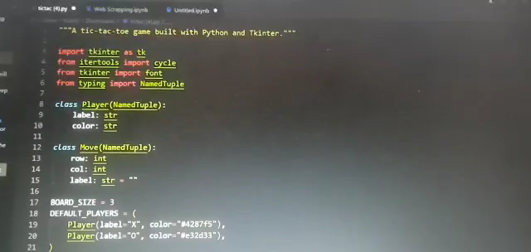
Python Code

Slide 7
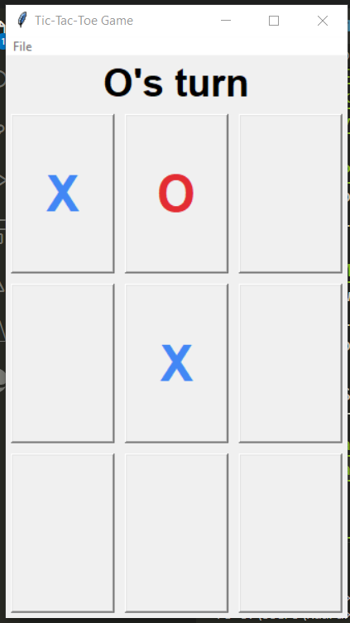
Play the game

Slide 8
Any Questions?
Thank you

